Slide 1
Database presentation
Matt Karpeal & Tyler Rollinson

Slide 2
The nonprofit database
Our database design was created to aid in the management of people associated with the program. Employees, volunteers, and donors are all managed through the system along with payroll and various other attributes.

Slide 3
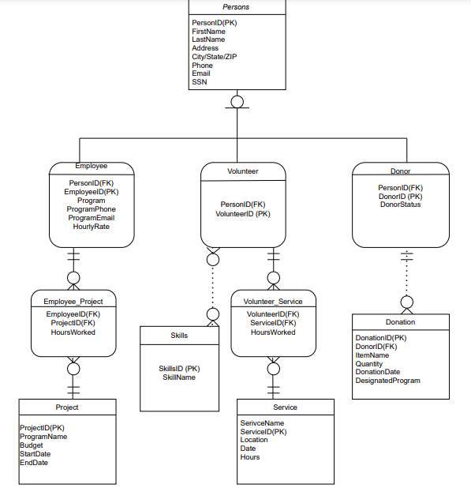
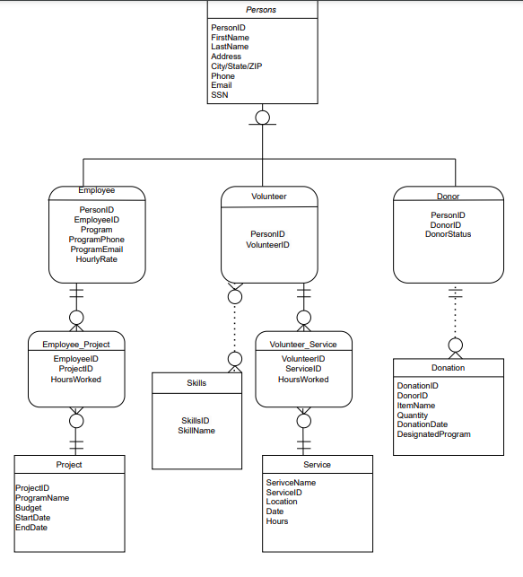
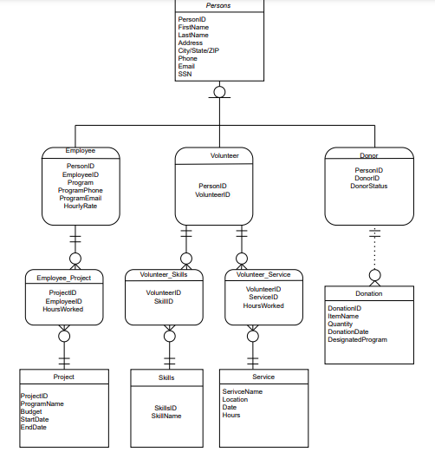
Data model
MARKET GAP
CUSTOMERS
COSTS
\

Slide 4
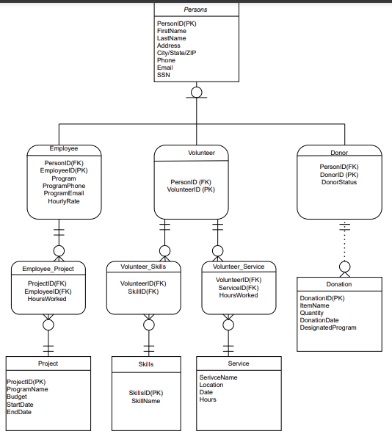
Design model
MARKET GAP
CUSTOMERS
COSTS
\

Slide 5
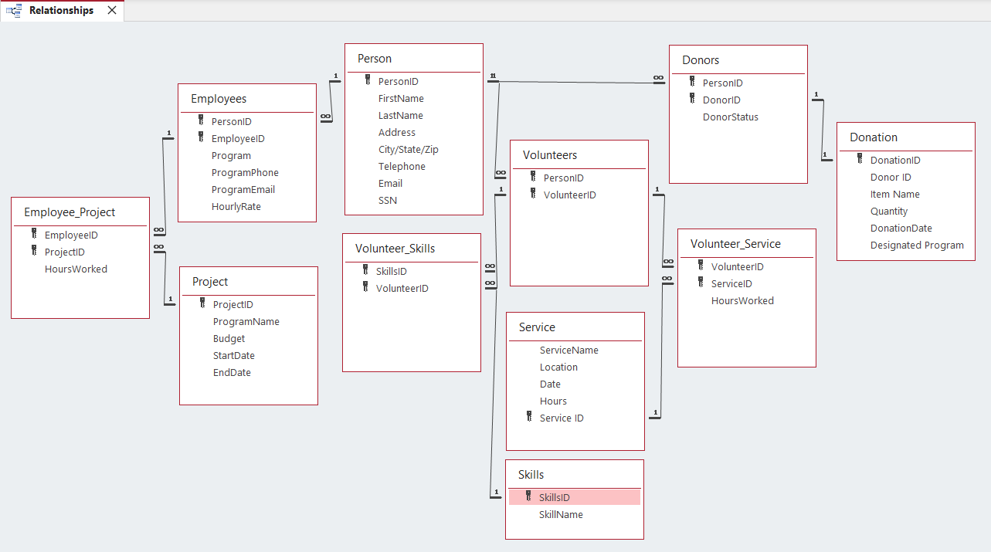
Relationships
FIRST TO MARKET
First beautifully designed product that's both stylish and functional
TESTED
Conducted testing with college students in the area
AUTHENTIC
Designed with the help and input of experts in the field

Slide 6
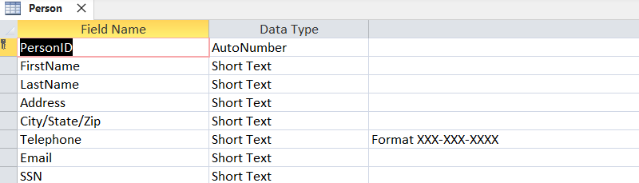
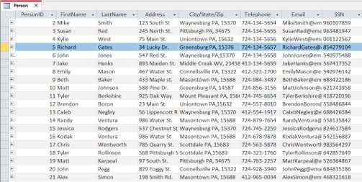
Tables
Person table Fig. 1.1

Slide 7
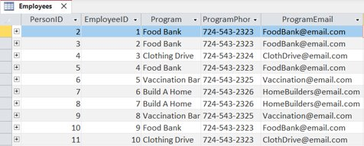
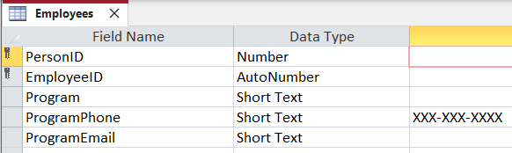
Employees table Fig 1.2

Slide 8
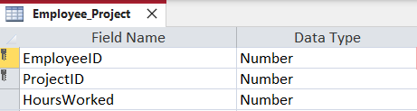
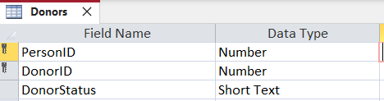
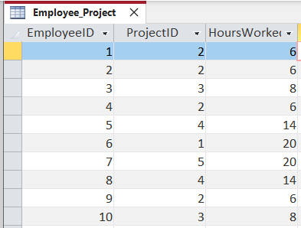
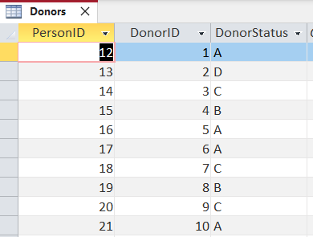
We based our research on market trends
DESIGN
We believe people need mo to this niche market
RESEARCH
Employee_Project table Fig. 1.3
Donors table Fig. 1.4

Slide 9
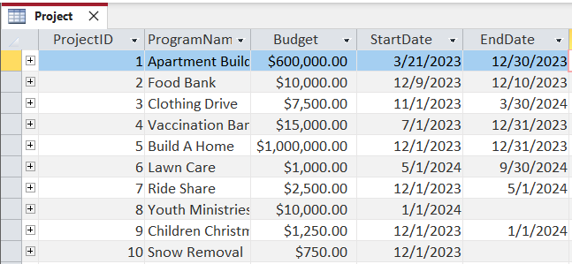
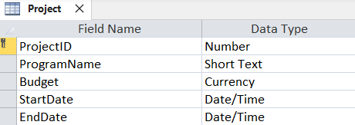
Project table Fig. 1.5

Slide 10
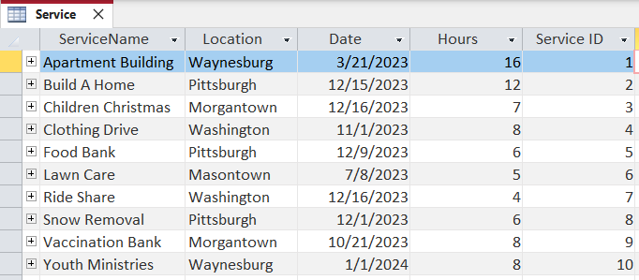
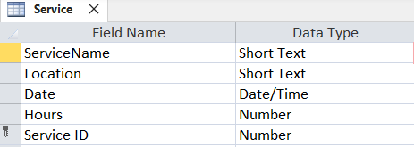
Project table Fig. 1.6

Slide 11
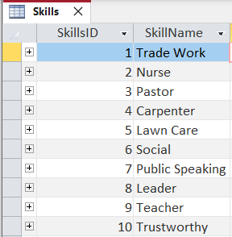
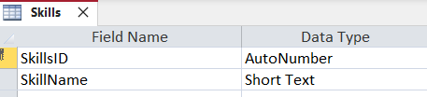
Skills table Fig. 1.7

Slide 12
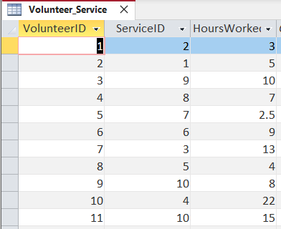
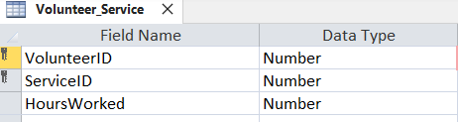
Volunteer_Service table Fig. 1.8

Slide 13
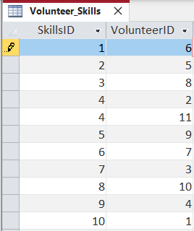

Volunteer_Skills table Fig. 1.9

Slide 14
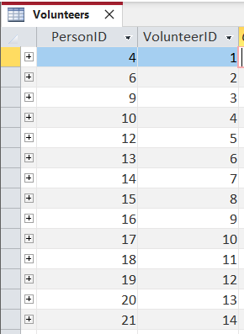

Volunteers table Fig. 1.10

Slide 15
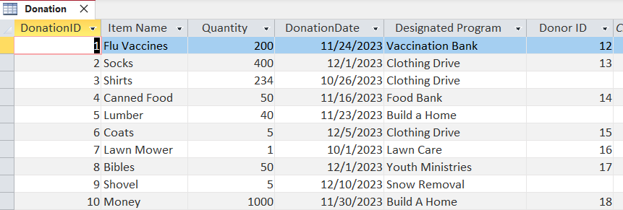
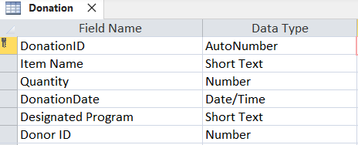
Donation table Fig 1.11

Slide 16
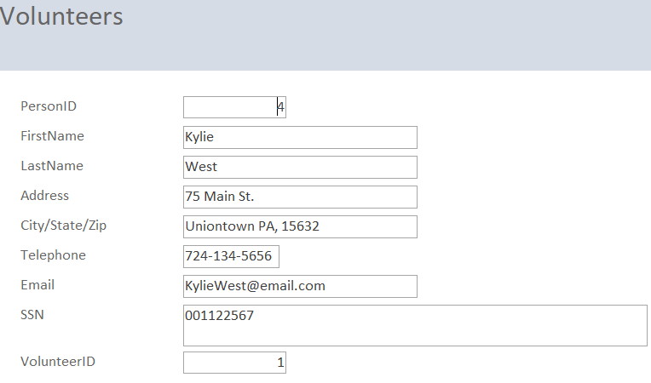
Data Entry Forms
Volunteer Form Fig. 1.12

Slide 17
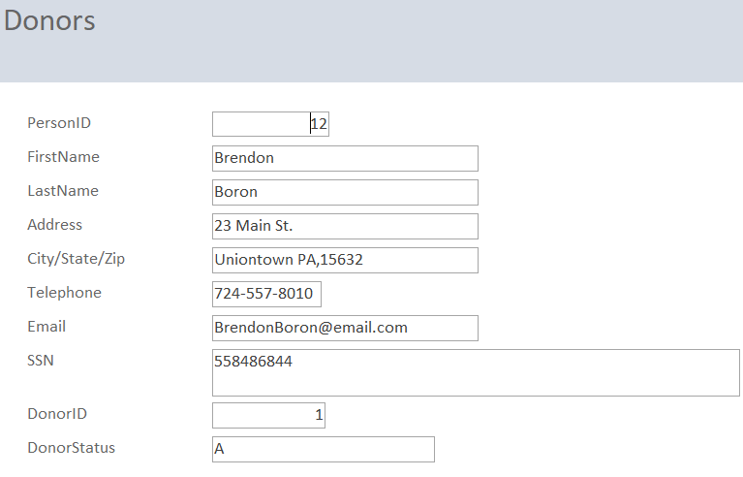
Donors Form Fig. 1.13

Slide 18
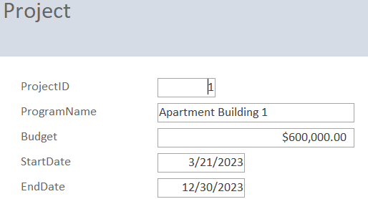
Project Form Fig. 1.14

Slide 19
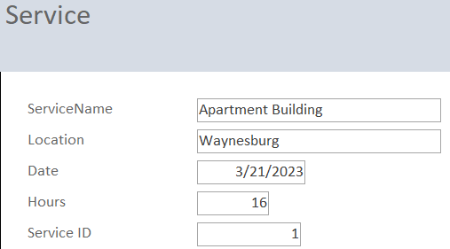
Service Form Fig.1.15

Slide 20
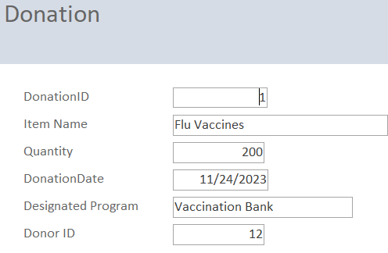
Donation Form Fig 1.16

Slide 21
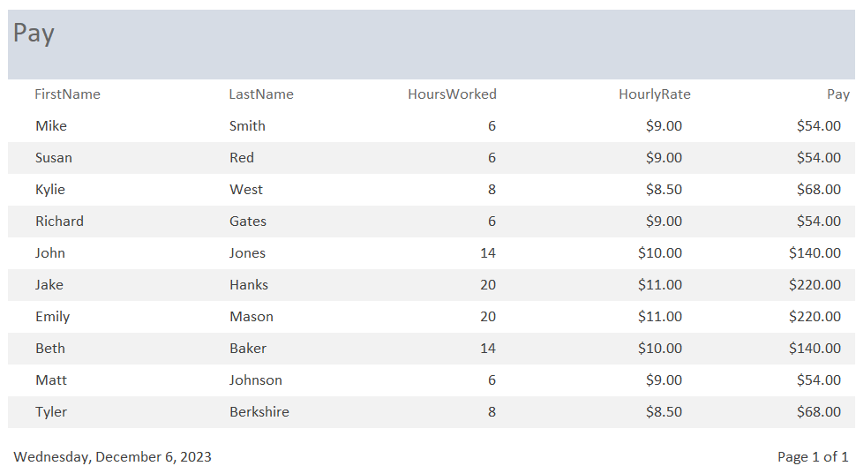
Reports
Pay Report Fig. 1.17

Slide 22
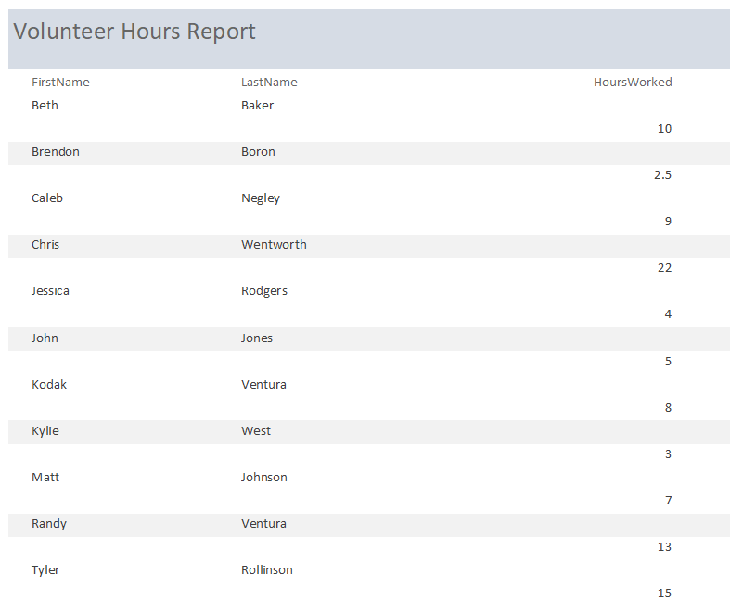
Volunteer Hours Report Fig. 1.18

Slide 23
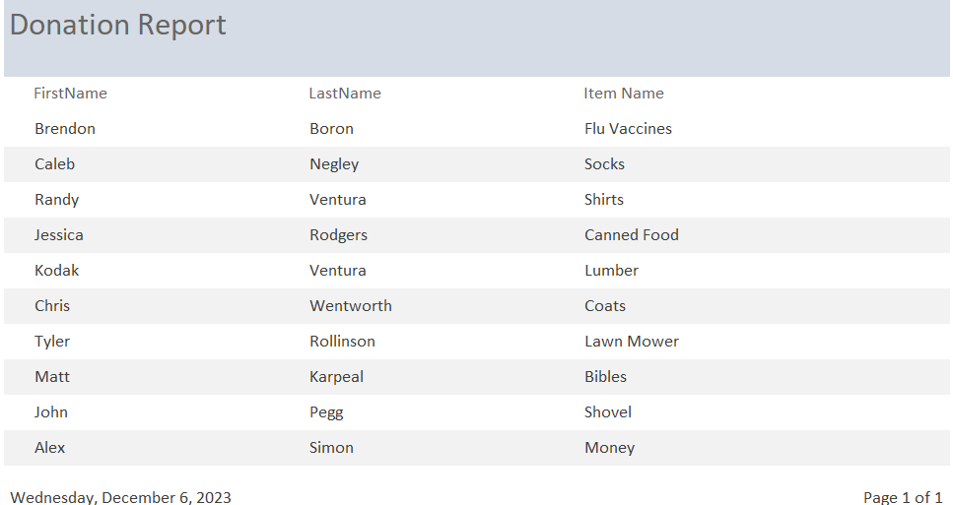
Donation Report Fig. 1.19

Slide 24
THANK YOU
Matt Karpeal & Tyler Rollinson
Database Design LLC
Copyright 2023

